Slide 1
Introduction to Economics
1HSB 2022_23

Slide 2
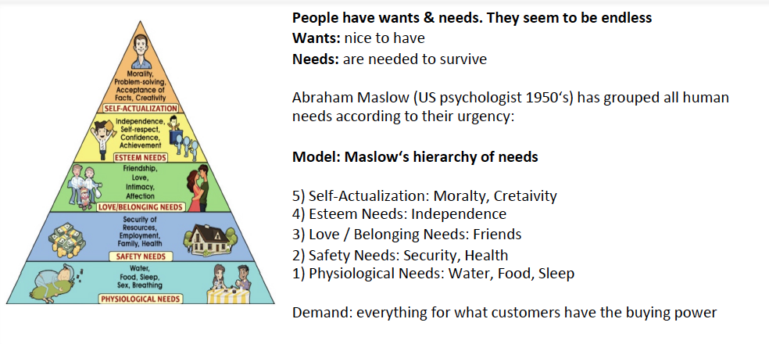
Hierchary of needs

Slide 3
Resources

Slide 4
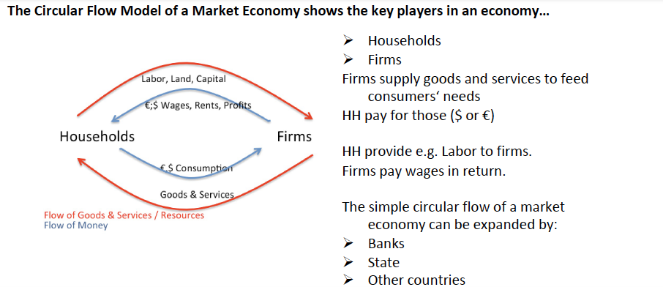
Circular Flow Model

Slide 5
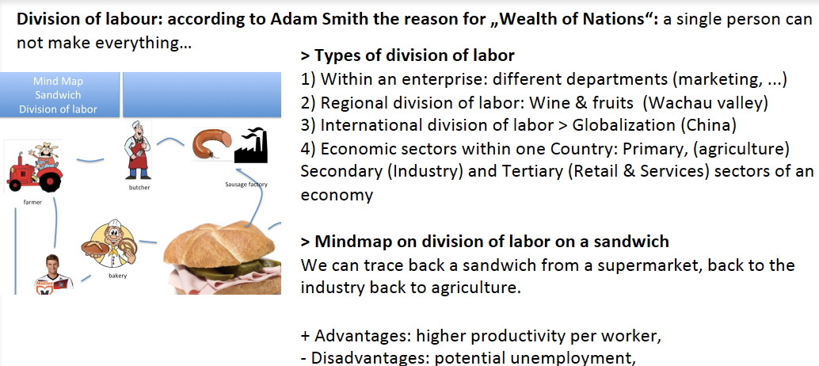
Division of labour

Slide 6
Market Model

Slide 7
Money

Slide 8
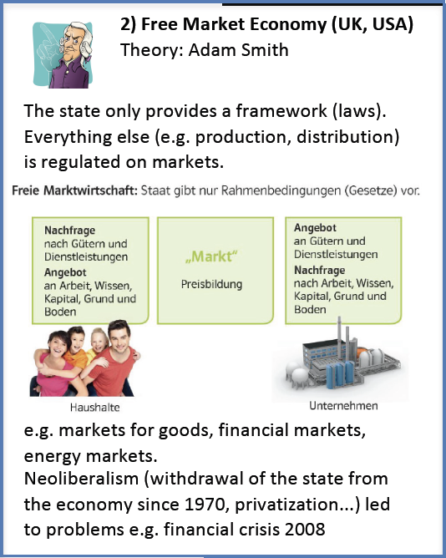
Economic Systems

Slide 9
Economic Systems

Slide 10
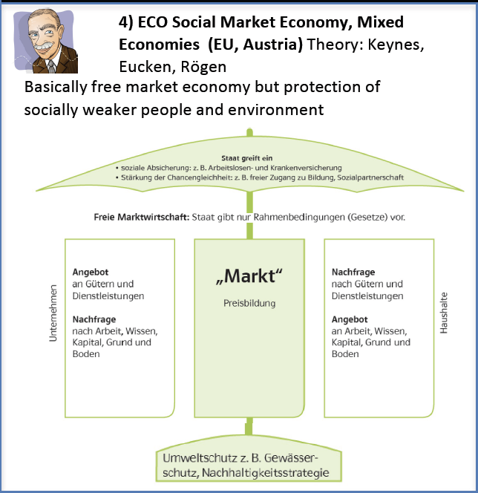
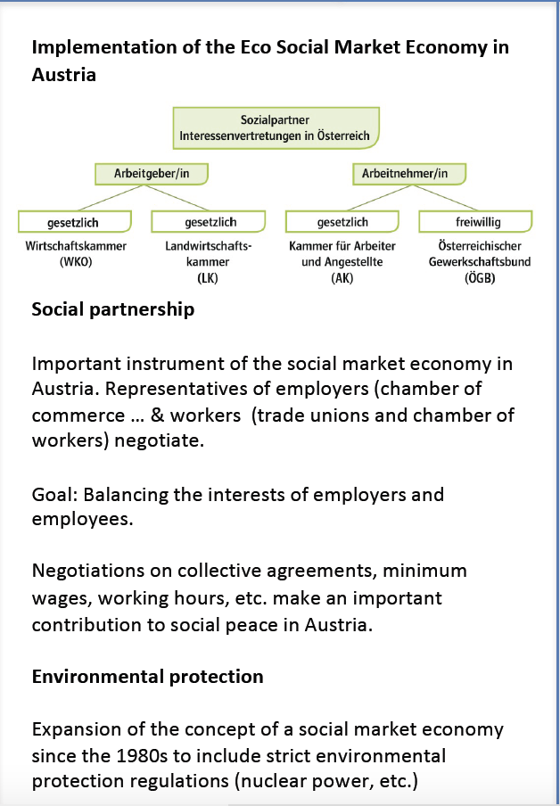
Economic Systems

Slide 11
GDP or how to measure the economy

Slide 12
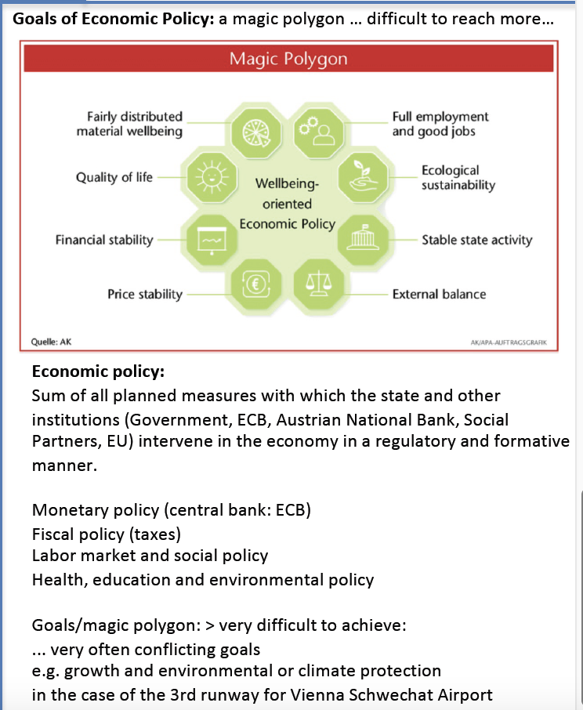
Goals in an Economy

