Slide 1
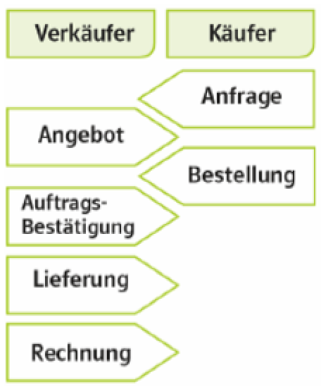
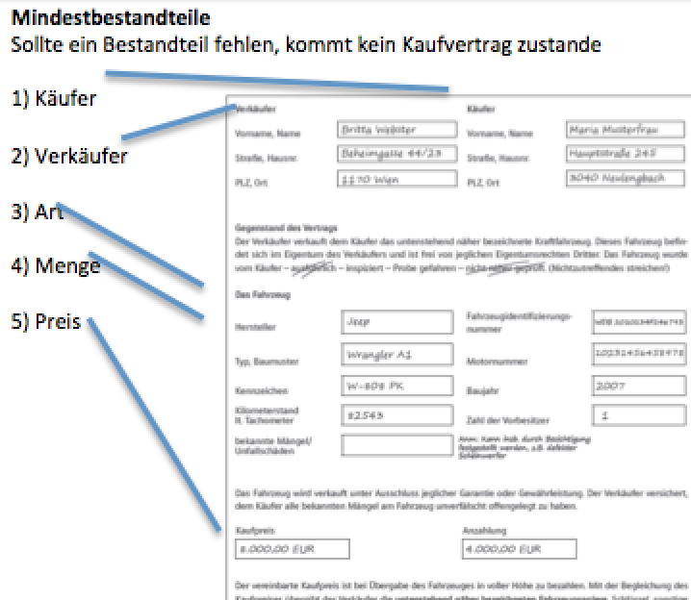
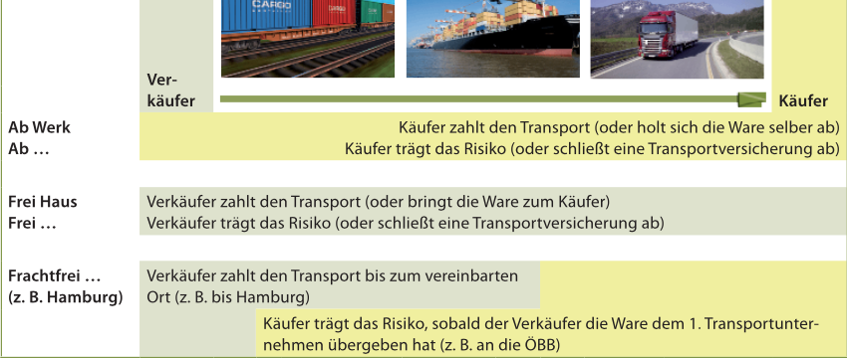
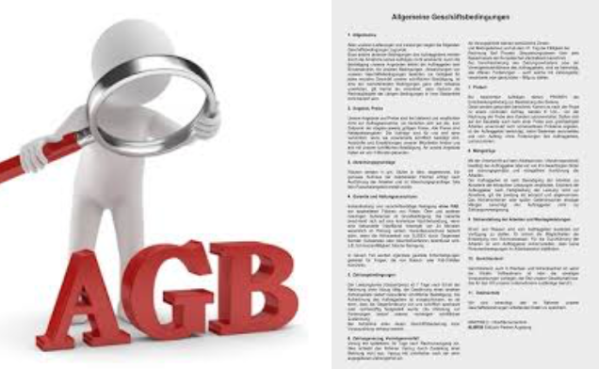
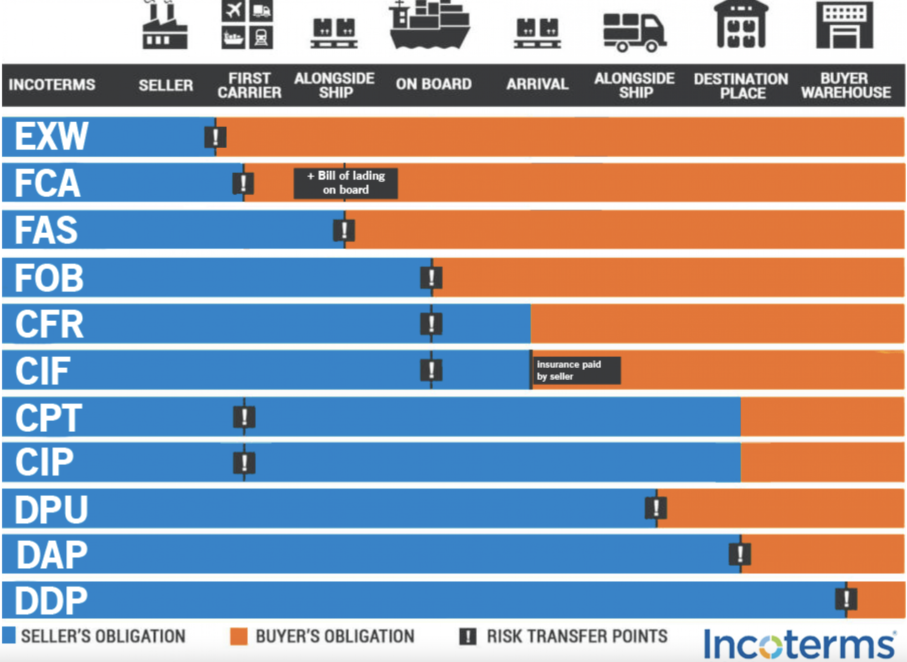
Sales Agreements Basics, and Elements
Goal/competencies: Being able to define sales contracts, being able to recognize prerequisites for sales contracts, being able to assess legal aspects (obligations, laws), being able to analyze components of sales contracts
1)What , How?
2)Prerequisits
3)What are the duties?
4)Which laws apply?
5)Phasen / Schritte im Verkaufsprozess
What:
Agreement on the transfer ownership of objects against payments
Form: written, oral,
electronic or conclusive actions
1) agreement of will (true agreement)
2) legal capacity (age)
3) Possibility (not e.g. time travel machine)
4) Permitted (not e.g. drugs)
5) Without coercion (voluntary)
Seller:
Delivery without defects
Timely delivery
Invoice according to USSTG
Buyer:
Timely payment
Acceptance
Specification
Vertragsverhältnis > Gesetze
C2C: ABGB (General Civil Code)
B2B: ABGB,
UGB (Entrepreneur Code)
USTG (Value Added Tax Act)
ECG (E-Commerce Act)
B2C: all of B2B +
KSchG (Consumer Protection Act)
Anbahnung
Abschluss
Erfüllung
(bei online Geschäfte zwingend, nicht im b2b)
6) Bestandteile:
Bezahlung
Agreement of will by
1 Binding offer + order
2 Order and order confirmation
3 Order and delivery
1) Legal fix elements
1) buyer | Business or private person
2) Seller | Business or private person
 | B2B business to business B2C business to consumer C2C consumer to consumer
3) Quantity | Exact Quantity e.g. 5 Liters ...
 | Aproximate Quantity
 | Purchase in bulk
 | z.B. the whole harvest…
 | … secification purchase, parts…
4)Type Quality | - Artikelnummer (Art.Nr......)
 | - Brands, Typen (Audi, A3...)
… | - Norms (Ö-Norm,...)
 | - illustrationss (Fotos,...)
 | - Muster (Bodenbelag)
 | - Inspections (KW)
 | - Commercial class (Eggs,...)
5) Price | Certain price
 | Determinable price
 | cost variation clause
 | index clause
 | Construction cost index
 | Inflation: consumer price index
 | Base price
 | stock exchange price
 | discounts (quantity, loyalty …)
 | Skonto (early payment discount)
2) Special arrangements for payments and delivery
Payment terms | If there is no agreement, payment is due on delivery
Type of payments | Payment target (e.g. 30 days after delivery)
Time arrangements | Early payment discount (skonto, 5% discount within 5 days..."
 | On target + early payment discount
 | Down payment or advance payment (An- und Vorauszahlung)
 | Partial or installment payment
 | Type of payment: card, bank transfer, cash…
INCO Terms 2020
Terms of delivery | No agreement: at the place of the seller
Place and date | 1-Point Inco terms: transfer of cost and risk on 1 place
Cost transfer- | Ex ..., free...,
Risc transfer | Ex works buyer has total cost and total risc
z.B. | Ex … specific place buyer has cost and risc from this place on
EXW: buyer bears… | Free house Seller has
DDP Seller bears… | frei ... Genannter Ort Verkäufer trägkt Kosten u Risiko bis ...
CIF Cost insurance freight | Zweipunktklauseln: Kosten- u Risikopübergang an 2 Punkten
 | frachtfrei ... z. B. „frachtfrei Bhf. Salzburg“
 | Verkäufer trägt Risiko bis 1. Transportunternehmen (ÖBB)
 | aber die Kosten bis zum genannten Ort, Bhf Salzburg
How to avoid | Delivery delay
Delivery delay | 1) Fixes business … fix on …
 | 2) Penalty: contractual penalty for late delivery
 | 3) Bank guarantee: in case of late delivery
Payment delay | Payment delay
 | 1) Deposit or advance payment: in part or shole
 | 2) Retention of title: Ownership is transferred after payment
 | 3) Bank guarantee: bank pays in case of late payment
3) Additional arrangements
General | Conditions of the seller
Conditions | “small print“
 | Grossly disadvantages rules are invalid
 | B2C unclear rules are invalid
 | Tip: read the general conditions
typical | Insurance conditions
conditions | Transport conditions
By industry | Travel conditions
Usancen | Trade customs
trade | z.B. see transport by container
Other | z.B. Packing
 | Packing is part of the delivery

